Slide 1
Relational Data Model
CS 236
Fall 2023

Slide 2
Overview
Topics – Using relational operators in a database
Project 3 hackathon?
Today’s lecture
Recorded TA help session
Due
Homework 15 due today
Homework 16 due Monday
Project 3 due Thursday, Nov 9
historically one of the more easy projects
be sure to see TA video or notes about __eq__ and __hash__

Slide 3
Datalog
Schemes:
childOf(P, C) # P - parent, C - child
marriedTo(S1, S2) # S1 - spouse, S2 - spouse
Facts:
marriedTo('Jack', 'Jill').
marriedTo('Annie', 'Aaron').
marriedTo('Molly', 'Matt').
childOf('Jack', 'Matt').
childOf('Annie', 'Molly').
childOf('Matt', 'Nate').
Rules:
childOf(Y, X) :- childOf(Z, X), marriedTo(Y, Z).
marriedTo(X, Y) :- marriedTo(Y, X).
Queries:
marriedTo('Jack', 'Jill')?
childOf('Aaron', 'Molly')?
childOf(P, 'Nate')?
A Datalog program defines a relational database
A Datalog program defines queries to run against the database

Slide 4
Datalog
Schemes:
childOf(P, C) # P - parent, C - child
marriedTo(S1, S2) # S1 - spouse, S2 - spouse
Facts:
marriedTo('Jack', 'Jill').
marriedTo('Annie', 'Aaron').
marriedTo('Molly', 'Matt').
childOf('Jack', 'Matt').
childOf('Annie', 'Molly').
childOf('Matt', 'Nate').
Rules:
childOf(Y, X) :- childOf(Z, X), marriedTo(Y, Z).
marriedTo(X, Y) :- marriedTo(Y, X).
Queries:
marriedTo('Jack', 'Jill')?
childOf('Aaron', 'Molly')?
childOf(P, 'Nate')?
A Datalog program defines a relational database
A Datalog program defines queries to run against the database
How to
Create database objects
Evaluate queries using relational operators

Slide 5
Project 3
Schemes:
childOf(P, C) # P - parent, C - child
marriedTo(S1, S2) # S1 - spouse, S2 - spouse
Facts:
marriedTo('Jack', 'Jill').
marriedTo('Annie', 'Aaron').
marriedTo('Molly', 'Matt').
childOf('Jack', 'Matt').
childOf('Annie', 'Molly').
childOf('Matt', 'Nate').
Rules:
childOf(Y, X) :- childOf(Z, X), marriedTo(Y, Z).
marriedTo(X, Y) :- marriedTo(Y, X).
Queries:
marriedTo('Jack', 'Jill')?
childOf('Aaron', 'Molly')?
childOf(P, 'Nate')?
Build the database
Create instance of Relation for each Scheme
Create instance of Tuple for each Fact
Add Tuple to correct Relation
Evaluate queries
Use Select, Project, and Rename

Slide 6
Project 3 Algorithm

Slide 7
Project 3 Elements
evaluate schemes & facts
schemes
facts
rules
queries
Project 2
Interpreter
Database
set of relations
evaluate queries
Query Database
Output

Slide 8
Project 3 Interpreter algorithm
for each scheme ‘s’
create a relation using name and parameter values from ‘s’
for each fact ‘f’
make a tuple ‘t’ using the values from ‘f’
add ‘t’ to relation with same name as ‘s’
for each query ‘q’
get the relation ‘r’ with same name as ‘q’
select for each constant (string) in ‘q’
select for each pair of matching variables (IDs) in ‘q’
project using the positions of the variables (IDs) in ‘q’
rename to match the names of variables in ‘q’
print the resulting relation

Slide 9
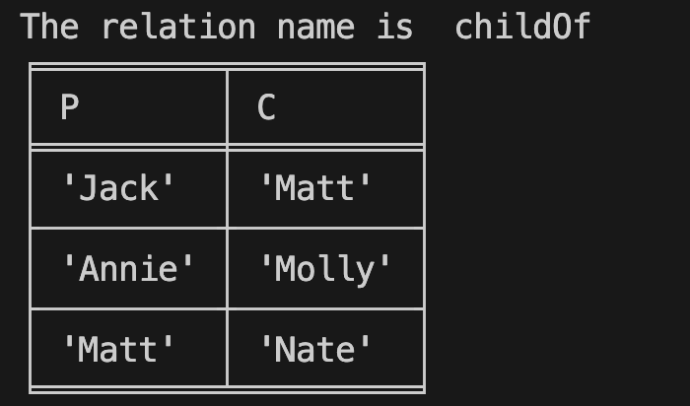
Project 3 Interpreter algorithm
for each scheme ‘s’
create a relation using name and parameter values from ‘s’
for each fact ‘f’
make a tuple ‘t’ using the values from ‘f’
add ‘t’ to relation with same name as ‘s’
for each query ‘q’
get the relation ‘r’ with same name as ‘q’
select for each constant (string) in ‘q’
select for each pair of matching variables (IDs) in ‘q’
project using the positions of the variables (IDs) in ‘q’
rename to match the names of variables in ‘q’
print the resulting relation
The relation and tuple classes

Slide 10
The Relation Class

Slide 11
Project 3 data structures
Build the database
Create instance of Relation for each Scheme
Create instance of Tuple for each Fact
Add Tuple to correct Relation
from project3_classes.r_tuple import R_Tuple
from project3_classes.header import Header
class Relation:
def __init__(self, relation_name: str, relation_header: list[str]) -> None:
self.name: str = relation_name
self.header: Header = Header(relation_header)
self.r_tuples: set[R_Tuple] = set()

Slide 12
Project 3 data structures
Build the database
Create instance of Relation for each Scheme
Create instance of Tuple for each Fact
Add Tuple to correct Relation
from project3_classes.r_tuple import R_Tuple
from project3_classes.header import Header
class Relation:
def __init__(self, relation_name: str, relation_header: list[str]) -> None:
self.name: str = relation_name
self.header: Header = Header(relation_header)
self.r_tuples: set[R_Tuple] = set()

Slide 13
Project 3 data structures
Schemes:
childOf(P, C) # P - parent, C - child
marriedTo(S1, S2) # S1 - spouse, S2 - spouse
from project3_classes.r_tuple import R_Tuple
from project3_classes.header import Header
class Relation:
def __init__(self, relation_name: str, relation_header: list[str]) -> None:
self.name: str = relation_name
self.header: Header = Header(relation_header)
self.r_tuples: set[R_Tuple] = set()

Slide 14
Project 3 data structures
Schemes:
childOf(P, C) # P - parent, C - child
marriedTo(S1, S2) # S1 - spouse, S2 - spouse
from project3_classes.r_tuple import R_Tuple
from project3_classes.header import Header
class Relation:
def __init__(self, relation_name: str, relation_header: list[str]) -> None:
self.name: str = relation_name
self.header: Header = Header(relation_header)
self.r_tuples: set[R_Tuple] = set()

Slide 15
Project 3 data structures
Build the database
Create instance of Relation for each Scheme
Create instance of Tuple for each Fact
Add Tuple to correct Relation
from project3_classes.r_tuple import R_Tuple
from project3_classes.header import Header
class Relation:
def __init__(self, relation_name: str, relation_header: list[str]) -> None:
self.name: str = relation_name
self.header: Header = Header(relation_header)
self.r_tuples: set[R_Tuple] = set()

Slide 16
Project 3 data structures
Facts:
marriedTo('Jack', 'Jill').
marriedTo('Annie', 'Aaron').
marriedTo('Molly', 'Matt').
childOf('Jack', 'Matt').
childOf('Annie', 'Molly').
childOf('Matt', 'Nate').
from project3_classes.r_tuple import R_Tuple
from project3_classes.header import Header
class Relation:
def __init__(self, relation_name: str, relation_header: list[str]) -> None:
self.name: str = relation_name
self.header: Header = Header(relation_header)
self.r_tuples: set[R_Tuple] = set()

Slide 17
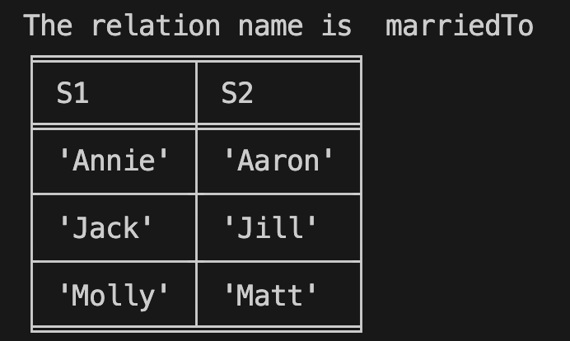
Project 3 data structures
Facts:
marriedTo('Jack', 'Jill').
marriedTo('Annie', 'Aaron').
marriedTo('Molly', 'Matt').
childOf('Jack', 'Matt').
childOf('Annie', 'Molly').
childOf('Matt', 'Nate').
from project3_classes.r_tuple import R_Tuple
from project3_classes.header import Header
class Relation:
def __init__(self, relation_name: str, relation_header: list[str]) -> None:
self.name: str = relation_name
self.header: Header = Header(relation_header)
self.r_tuples: set[R_Tuple] = set()

Slide 18
The Tuple Class

Slide 19
Why define our own tuple class?
“tuple” is a reserved word in Python that defines a tuple type
tuple types are immutable
once created, can’t change
We want to be able to switch columns a la π_{DC}
from project3_classes.r_tuple import R_Tuple
class Relation:
def __init__(self, relation_name: str, relation_header: list[str]) -> None:
self.r_tuples: set[R_Tuple] = set()

Slide 20
Why define our own tuple class?
“tuple” is a reserved word in Python that defines a tuple type
tuple types are immutable
once created, can’t change
We want to be able to switch columns a la π_{DC}
Three problems
sets can’t repeat elements
sets are implemented using hashing
r_tuples must be sortable
from project3_classes.r_tuple import R_Tuple
class Relation:
def __init__(self, relation_name: str, relation_header: list[str]) -> None:
self.r_tuples: set[R_Tuple] = set()

Slide 21
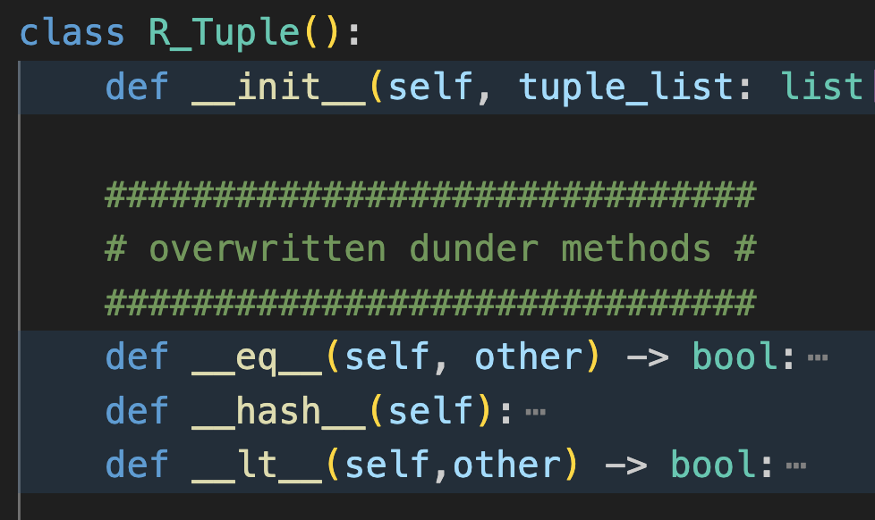
Why define our own tuple class?
Three problems
sets can’t repeat elements
sets are implemented using hashing
r_tuples must be sortable

Slide 22
Why define our own tuple class?
Three problems
sets can’t repeat elements
sets are implemented using hashing
r_tuples must be sortable
each class has default dunder functions
dunder = double underscore
equal
hash
less than

Slide 23
Why define our own tuple class?
Three problems
sets can’t repeat elements
sets are implemented using hashing
r_tuples must be sortable
each class has default dunder functions
dunder = double underscore
equal
hash
less than
solve the three problems by overwriting the dunder methods
TA help info provides two solutions to the sorting problem

Slide 24
Project 3 Algorithm continued …

Slide 25
Project 3 Interpreter algorithm
for each scheme ‘s’
create a relation using name and parameter values from ‘s’
for each fact ‘f’
make a tuple ‘t’ using the values from ‘f’
add ‘t’ to relation with same name as ‘s’
for each query ‘q’
get the relation ‘r’ with same name as ‘q’
select for each constant (string) in ‘q’
select for each pair of matching variables (IDs) in ‘q’
project using the positions of the variables (IDs) in ‘q’
rename to match the names of variables in ‘q’
print the resulting relation

Slide 26
Project 3 Interpreter
Database
for each query ‘q’
get the relation ‘r’ with same name as ‘q’
select for each constant (string) in ‘q’
select for each pair of matching variables (IDs) in ‘q’
project using the positions of the variables (IDs) in ‘q’
rename to match the names of variables in ‘q’
print the resulting relation

Slide 27
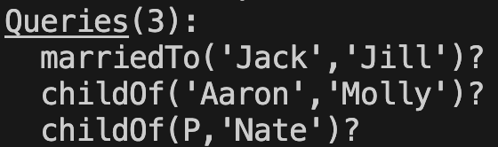
Project 3 Interpreter
Database
for each query ‘q’
get the relation ‘r’ with same name as ‘q’
select for each constant (string) in ‘q’
select for each pair of matching variables (IDs) in ‘q’
project using the positions of the variables (IDs) in ‘q’
rename to match the names of variables in ‘q’
print the resulting relation
Queries

Slide 28
Project 3 Interpreter
Database
for each query ‘q’
get the relation ‘r’ with same name as ‘q’
select for each constant (string) in ‘q’
select for each pair of matching variables (IDs) in ‘q’
project using the positions of the variables (IDs) in ‘q’
rename to match the names of variables in ‘q’
print the resulting relation
Queries

Slide 29
Project 3 Interpreter
Database
for each query ‘q’
get the relation ‘r’ with same name as ‘q’
select for each constant (string) in ‘q’
select for each pair of matching variables (IDs) in ‘q’
project using the positions of the variables (IDs) in ‘q’
rename to match the names of variables in ‘q’
print the resulting relation
Queries

Slide 30
Project 3 Interpreter
for each query ‘q’
get the relation ‘r’ with same name as ‘q’
select for each constant (string) in ‘q’
select for each pair of matching variables (IDs) in ‘q’
project using the positions of the variables (IDs) in ‘q’
rename to match the names of variables in ‘q’
print the resulting relation

Slide 31
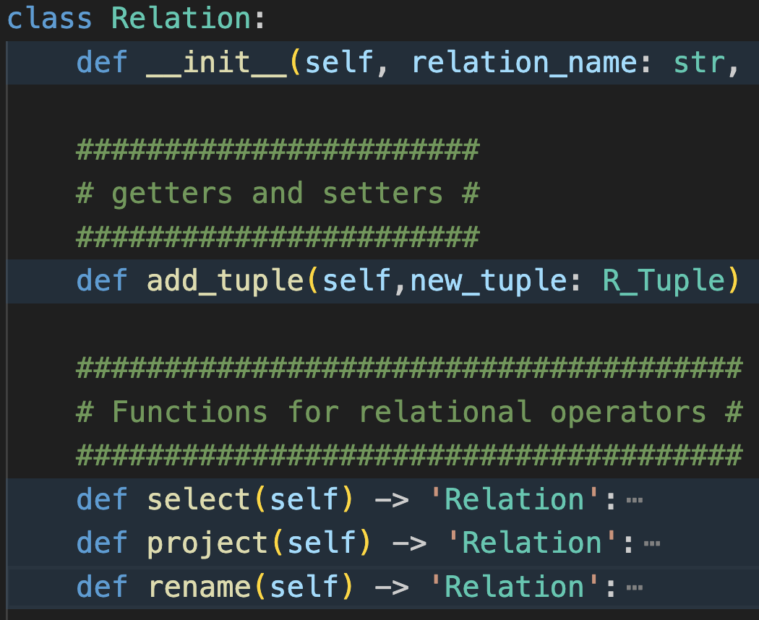
Project 3 Interpreter
Relation Class
for each query ‘q’
get the relation ‘r’ with same name as ‘q’
select for each constant (string) in ‘q’
select for each pair of matching variables (IDs) in ‘q’
project using the positions of the variables (IDs) in ‘q’
rename to match the names of variables in ‘q’
print the resulting relation
Relation
Unary operator
New Relation

Slide 32
Project 3 Interpreter
Relation Class
for each query ‘q’
get the relation ‘r’ with same name as ‘q’
select for each constant (string) in ‘q’
select for each pair of matching variables (IDs) in ‘q’
project using the positions of the variables (IDs) in ‘q’
rename to match the names of variables in ‘q’
print the resulting relation
Relation
Unary operator
New Relation

Slide 33
First Select Type

Slide 34
Project 3 Interpreter
Database
for each query ‘q’
get the relation ‘r’ with same name as ‘q’
select for each constant (string) in ‘q’
select for each pair of matching variables (IDs) in ‘q’
project using the positions of the variables (IDs) in ‘q’
rename to match the names of variables (IDs) in ‘q’
print the resulting relation
Queries

Slide 35
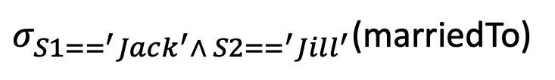
Project 3 Interpreter
Database
for each query ‘q’
get the relation ‘r’ with same name as ‘q’
select for each constant (string) in ‘q’
select for each pair of matching variables (IDs) in ‘q’
project using the positions of the variables (IDs) in ‘q’
rename to match the names of variables (IDs) in ‘q’
print the resulting relation
Queries
$σ_{S1==^{′}Jack^{′}∧ S2==^{′}Jill^{′}}$(marriedTo)

Slide 36
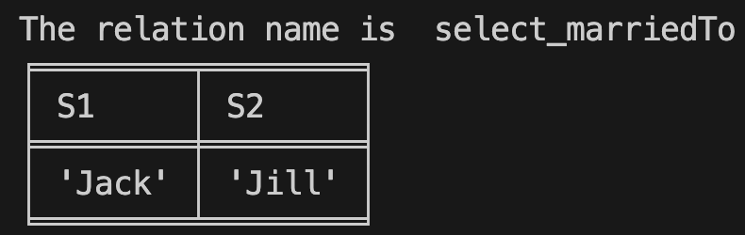
Project 3 Interpreter
Database
for each query ‘q’
get the relation ‘r’ with same name as ‘q’
select for each constant (string) in ‘q’
select for each pair of matching variables (IDs) in ‘q’
project using the positions of the variables (IDs) in ‘q’
rename to match the names of variables (IDs) in ‘q’
print the resulting relation
Queries
New Relation
$σ_{S1==^{′}Jack^{′}∧ S2==^{′}Jill^{′}}$(marriedTo)

Slide 37
Project 3 Interpreter
Database
for each query ‘q’
get the relation ‘r’ with same name as ‘q’
select for each constant (string) in ‘q’
select for each pair of matching variables (IDs) in ‘q’
project using the positions of the variables (IDs) in ‘q’
rename to match the names of variables (IDs) in ‘q’
print the resulting relation
Relation
Unary operator
New Relation
Queries
New Relation
$σ_{S1==^{′}Jack^{′}∧ S2==^{′}Jill^{′}}$(marriedTo)

Slide 38
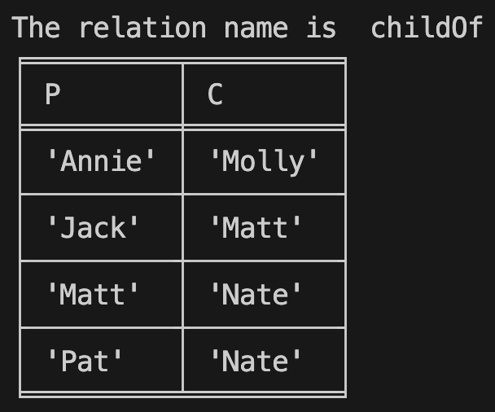
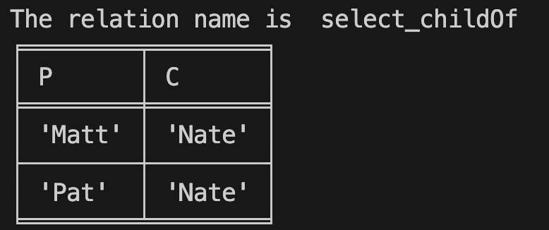
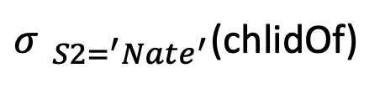
Project 3 Interpreter
Database
for each query ‘q’
get the relation ‘r’ with same name as ‘q’
select for each constant (string) in ‘q’
select for each pair of matching variables (IDs) in ‘q’
project using the positions of the variables (IDs) in ‘q’
rename to match the names of variables (IDs) in ‘q’
print the resulting relation
Queries
New Relation
$σ_{ S2=^{′}Nate^{′}}$(chlidOf)

Slide 39
Second Select Type

Slide 40
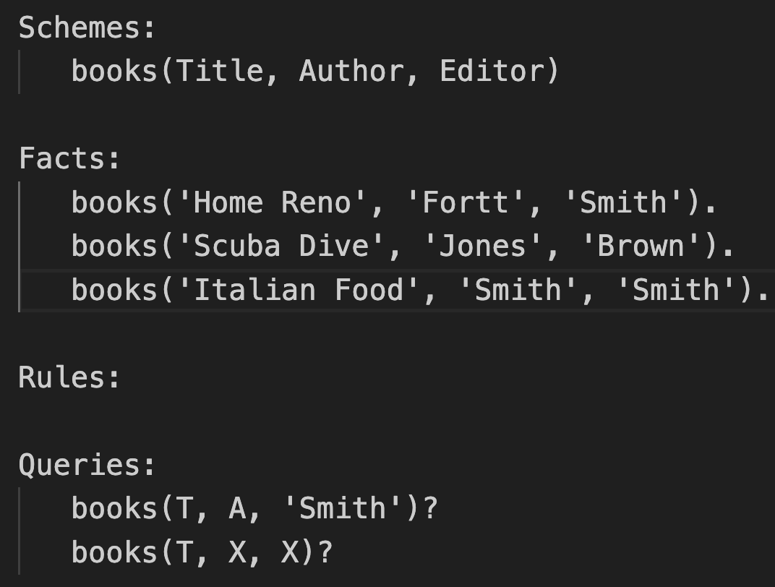
Project 3 Interpreter
for each query ‘q’
get the relation ‘r’ with same name as ‘q’
select for each constant (string) in ‘q’
select for each pair of matching variables (IDs) in ‘q’
project using the positions of the variables (IDs) in ‘q’
rename to match the names of variables (IDs) in ‘q’
print the resulting relation

Slide 41
Project 3 Interpreter
for each query ‘q’
get the relation ‘r’ with same name as ‘q’
select for each constant (string) in ‘q’
select for each pair of matching variables (IDs) in ‘q’
project using the positions of the variables (IDs) in ‘q’
rename to match the names of variables (IDs) in ‘q’
print the resulting relation
Queries

Slide 42
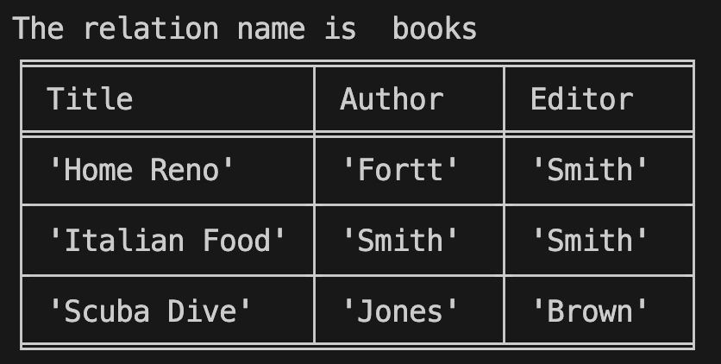
Project 3 Interpreter
Database
for each query ‘q’
get the relation ‘r’ with same name as ‘q’
select for each constant (string) in ‘q’
select for each pair of matching variables (IDs) in ‘q’
project using the positions of the variables (IDs) in ‘q’
rename to match the names of variables (IDs) in ‘q’
print the resulting relation
Queries

Slide 43
Project 3 Interpreter
Database
for each query ‘q’
get the relation ‘r’ with same name as ‘q’
select for each constant (string) in ‘q’
select for each pair of matching variables (IDs) in ‘q’
project using the positions of the variables (IDs) in ‘q’
rename to match the names of variables (IDs) in ‘q’
print the resulting relation
Queries
This says to look up all books
that have the same author & editor

Slide 44
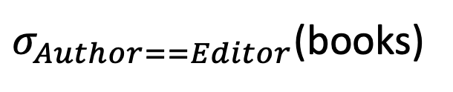
Project 3 Interpreter
Database
for each query ‘q’
get the relation ‘r’ with same name as ‘q’
select for each constant (string) in ‘q’
select for each pair of matching variables (IDs) in ‘q’
project using the positions of the variables (IDs) in ‘q’
rename to match the names of variables (IDs) in ‘q’
print the resulting relation
Queries
$σ_{Author==Editor}$(books)

Slide 45
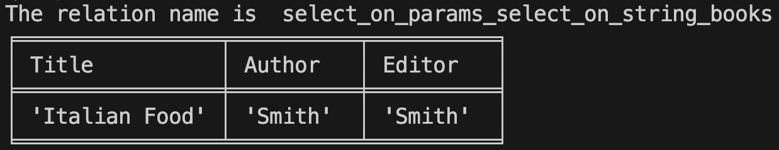
Project 3 Interpreter
Database
for each query ‘q’
get the relation ‘r’ with same name as ‘q’
select for each constant (string) in ‘q’
select for each pair of matching variables (IDs) in ‘q’
project using the positions of the variables (IDs) in ‘q’
rename to match the names of variables (IDs) in ‘q’
print the resulting relation
Queries
New Relation
$σ_{Author==Editor}$(books)

Slide 46
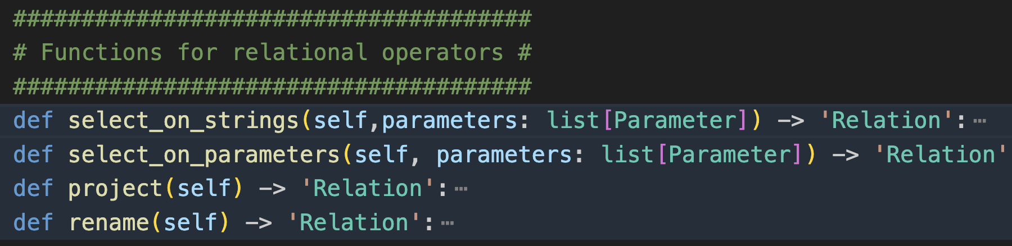
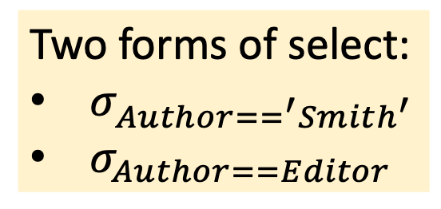
Project 3 Interpreter
Two forms of select:
$σ_{Author==^{′}Smith^{′}}$
$σ_{Author==Editor}$
for each query ‘q’
get the relation ‘r’ with same name as ‘q’
select for each constant (string) in ‘q’
select for each pair of matching variables (IDs) in ‘q’
project using the positions of the variables (IDs) in ‘q’
rename to match the names of variables (IDs) in ‘q’
print the resulting relation
$σ_{Author==Editor}$(books)

Slide 47
Answering the Query

Slide 48
Project 3 Interpreter
Database
for each query ‘q’
get the relation ‘r’ with same name as ‘q’
select for each constant (string) in ‘q’
select for each pair of matching variables (IDs) in ‘q’
project using the positions of the variables (IDs) in ‘q’
rename to match the names of variables (IDs) in ‘q’
print the resulting relation
Queries

Slide 49
Project 3 Interpreter
Database
for each query ‘q’
get the relation ‘r’ with same name as ‘q’
select for each constant (string) in ‘q’
select for each pair of matching variables (IDs) in ‘q’
project using the positions of the variables (IDs) in ‘q’
rename to match the names of variables (IDs) in ‘q’
print the resulting relation
Queries
What are the queries asking?
What are the titles and authors of all books edited by ‘Smith’
What are the titles of all books that have the same author and editor

Slide 50
Project 3 Interpreter
Database
for each query ‘q’
get the relation ‘r’ with same name as ‘q’
select for each constant (string) in ‘q’
select for each pair of matching variables (IDs) in ‘q’
project using the positions of the variables (IDs) in ‘q’
rename to match the names of variables (IDs) in ‘q’
print the resulting relation
Queries
What are the queries asking?
What are the titles and authors of all books edited by ‘Smith’
What are the titles of all books that have the same author and editor
Project and rename give these answers

Slide 51
Answering the Query – Project

Slide 52
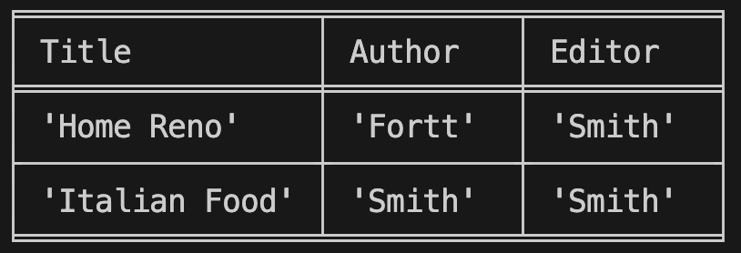
Project 3 Interpreter
Database after Selects
for each query ‘q’
get the relation ‘r’ with same name as ‘q’
select for each constant (string) in ‘q’
select for each pair of matching variables (IDs) in ‘q’
project using the positions of the variables (IDs) in ‘q’
rename to match the names of variables (IDs) in ‘q’
print the resulting relation
Queries
Don’t keep strings around

Slide 53
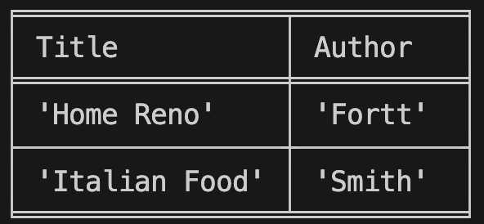
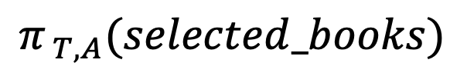
Project 3 Interpreter
Database after Selects
for each query ‘q’
get the relation ‘r’ with same name as ‘q’
select for each constant (string) in ‘q’
select for each pair of matching variables (IDs) in ‘q’
project using the positions of the variables (IDs) in ‘q’
rename to match the names of variables (IDs) in ‘q’
print the resulting relation
$$π_{ T,A}(selected_books)$$
Queries
Don’t keep strings around

Slide 54
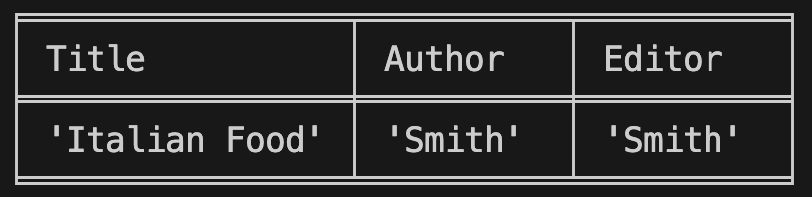
Project 3 Interpreter
Database after Selects
for each query ‘q’
get the relation ‘r’ with same name as ‘q’
select for each constant (string) in ‘q’
select for each pair of matching variables (IDs) in ‘q’
project using the positions of the variables (IDs) in ‘q’
rename to match the names of variables (IDs) in ‘q’
print the resulting relation
Queries
Don’t keep strings around
Don’t keep duplicates around

Slide 55
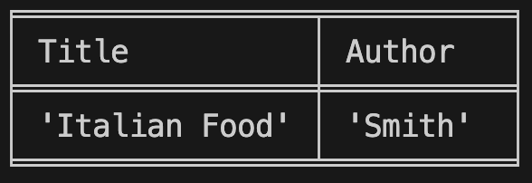
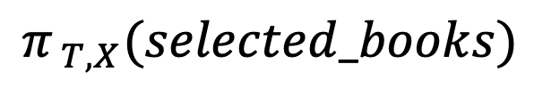
Project 3 Interpreter
Database after Selects
for each query ‘q’
get the relation ‘r’ with same name as ‘q’
select for each constant (string) in ‘q’
select for each pair of matching variables (IDs) in ‘q’
project using the positions of the variables (IDs) in ‘q’
rename to match the names of variables (IDs) in ‘q’
print the resulting relation
$$π_{ T,X}(selected_books)$$
Queries
Don’t keep strings around
Don’t keep duplicates around

Slide 56
Project 3 Interpreter
Database after Selects and Project
for each query ‘q’
get the relation ‘r’ with same name as ‘q’
select for each constant (string) in ‘q’
select for each pair of matching variables (IDs) in ‘q’
project using the positions of the variables (IDs) in ‘q’
rename to match the names of variables (IDs) in ‘q’
print the resulting relation
Queries
Problem: Attribute names don’t match
Solution: rename

Slide 57
Answering the Query – Rename

Slide 58
Project 3 Interpreter
Database after Selects and Project
for each query ‘q’
get the relation ‘r’ with same name as ‘q’
select for each constant (string) in ‘q’
select for each pair of matching variables (IDs) in ‘q’
project using the positions of the variables (IDs) in ‘q’
rename to match the names of variables (IDs) in ‘q’
print the resulting relation
Queries
Problem: Attribute names don’t match
Solution: rename

Slide 59
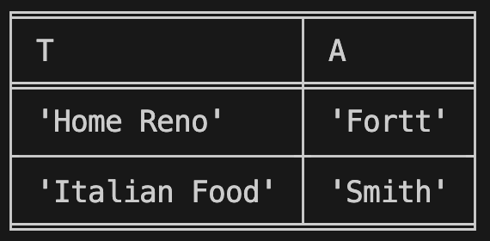
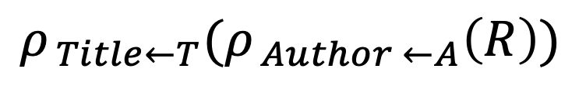
Project 3 Interpreter
Database after Selects and Project
for each query ‘q’
get the relation ‘r’ with same name as ‘q’
select for each constant (string) in ‘q’
select for each pair of matching variables (IDs) in ‘q’
project using the positions of the variables (IDs) in ‘q’
rename to match the names of variables (IDs) in ‘q’
print the resulting relation
$$ρ_{ Title←T}(ρ_{ Author ←A}\left(R\right))$$
Queries
Problem: Attribute names don’t match
Solution: rename

Slide 60
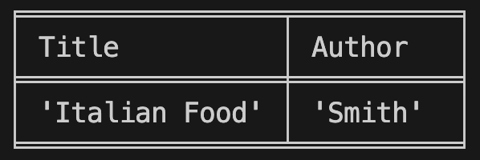
Project 3 Interpreter
Database after Selects and Project
for each query ‘q’
get the relation ‘r’ with same name as ‘q’
select for each constant (string) in ‘q’
select for each pair of matching variables (IDs) in ‘q’
project using the positions of the variables (IDs) in ‘q’
rename to match the names of variables (IDs) in ‘q’
print the resulting relation
Queries
Problem: Attribute names don’t match
Solution: rename

Slide 61
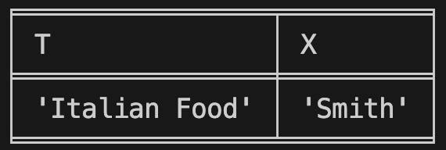
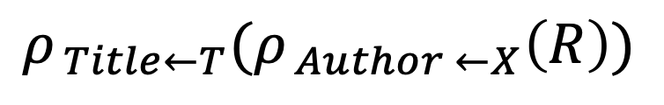
Project 3 Interpreter
Database after Selects and Project
for each query ‘q’
get the relation ‘r’ with same name as ‘q’
select for each constant (string) in ‘q’
select for each pair of matching variables (IDs) in ‘q’
project using the positions of the variables (IDs) in ‘q’
rename to match the names of variables (IDs) in ‘q’
print the resulting relation
$$ρ_{ Title←T}(ρ_{ Author ←X}\left(R\right))$$
Queries
Problem: Attribute names don’t match
Solution: rename

Slide 62
Print Response to Query

Slide 63
Project 3 Interpreter
Database
for each query ‘q’
get the relation ‘r’ with same name as ‘q’
select for each constant (string) in ‘q’
select for each pair of matching variables (IDs) in ‘q’
project using the positions of the variables (IDs) in ‘q’
rename to match the names of variables (IDs) in ‘q’
print the resulting relation
Database after Selects, Project, Renames

Slide 64
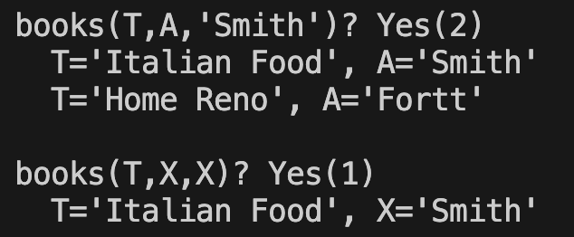
Project 3 Interpreter
Answers
for each query ‘q’
get the relation ‘r’ with same name as ‘q’
select for each constant (string) in ‘q’
select for each pair of matching variables (IDs) in ‘q’
project using the positions of the variables (IDs) in ‘q’
rename to match the names of variables (IDs) in ‘q’
print the resulting relation
Database after Selects, Project, Renames

